Slide 1


SEQUENCE IDENTITY & AUTO-INCREMENT IN SNOWFLAKE

Slide 2
SEQUENCE
ROW Numbers : SEQUENCE object and IDENTITY property use to generate a sequence of numeric values in an ascending order.
Generating Sequences with Snowflake is straight forward like other Databases such as Oracle, While the value in an identity column created by the server.
However, being same in functionality, there are several differences among Row Numbers i.e. the IDENTITY property and SEQUENCE object.

Slide 3
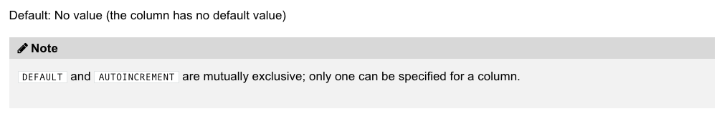
Snowflake uses a sequence to generate the values for an auto-incremented column.
Sequences have limitations; see Sequence Semantics.
The default value for both start and step/increment is 1.
AUTOINCREMENT and IDENTITY can be used only for columns with numeric data types.

Slide 4
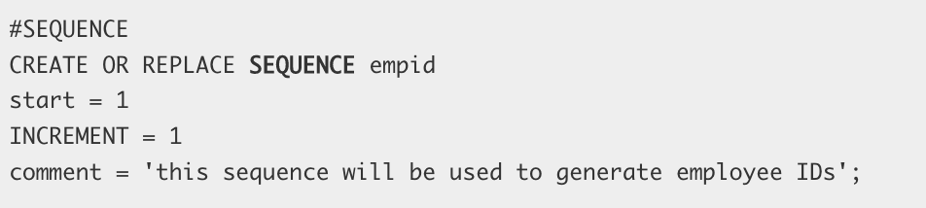
SEQUENCE CODE

Slide 5
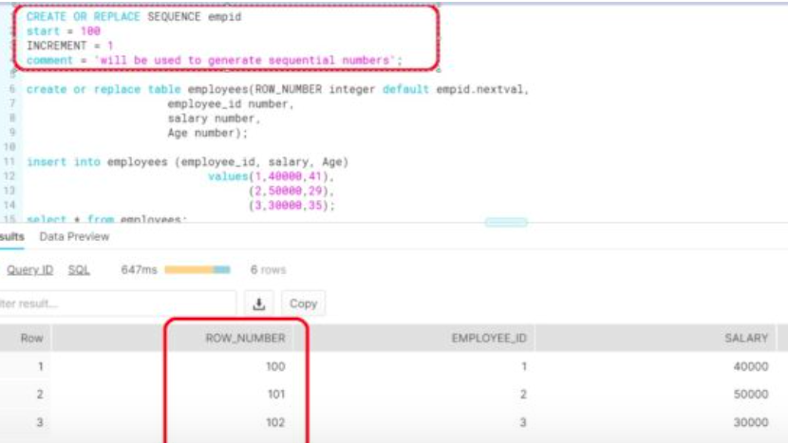
SEQUENCE IMPLEMENTATION

Slide 6
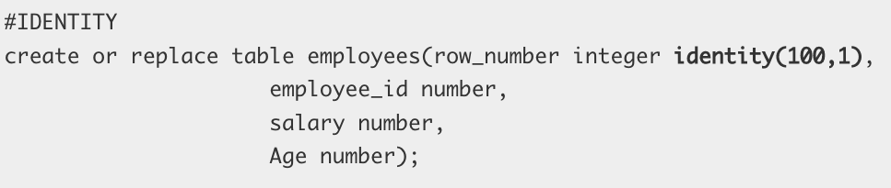
IDENTITY

Slide 7
Association
SEQUENCE object are define by the user and can be share by multiple tables since is it is not tie to any table.
IDENTITY property ties to a particular table and cannot be shared among multiple tables since it is a table column property.

Slide 8
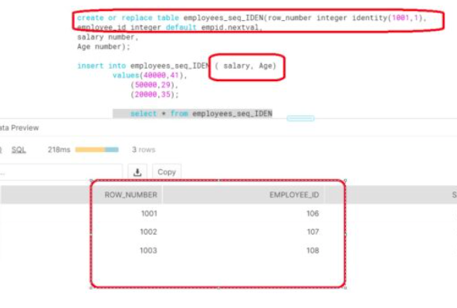
ASSOCIATION

Slide 9
Value Generation:
However, In order to generate the next IDENTITY value, it is must we should insert a new row into the table.
On the other hand, the next VALUE for a SEQUENCE object can simply be generated using the SEQ.NEXTVAL clause with the sequence object.
Example:
For instance, There is no alternative to get the next value for the IDENTITY property tied to the row_number column of employees_IDEN table, except by inserting a new row in the table. On the other hand, the value for a SEQUENCE object can be incremented without inserting a row into a table. Execute the following script:
select empid.nextval

Slide 10
Value Reset:
IDENTITY property cannot reset to its initial value. In contrast, the value for the SEQUENCE object can reset by recreating the Sequences. Traditionally CYCLE parameter is not available in Snowflake like SQL/ORACLE.
Auto Increment and Identity:
Similarly, Auto Increment is a function that operates on numeric data types. Hence, It automatically generates sequential numeric values every time that a record inserts into a table for a field defined as auto increment.
Column constraints AUTO_INCREMENT and IDENTITY are synonyms that associate a column with a sequence. This sequence automatically increments the column value as new rows adds to the table.
You define an AUTO_INCREMENT/IDENTITY column in a table as follows:

Slide 11

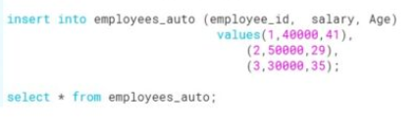
AUTO_INCREEMENT CODE

Slide 12

Auto Increment
AUTO_INCREMENT/IDENTITY sequences are owned by the table in which they are defined, and do not exist outside that table.
Unlike named sequences, you cannot manage an AUTO_INCREMENT/IDENTITY sequence with ALTER SEQUENCE.

Slide 13


